Slide 1
Chicago Crime and Population
IS A CRIME RATE HIGHER WHEN THE POPULATION OF THE NEIGHBORHOOD IS HIGHER? A STUDY OF CHICAGO CRIME RATES IN COMMUNITY AREAS & sIDES

Slide 2
Hypothesis and Null Hypothesis
Hypothesis: If the population of a neighborhood is greater than the average, then the crime reported will be greater than the average.
Null Hypothesis: The given population of a neighborhood has no impact on the number of crimes reported in a year.

Slide 3
Data: Where it came from
Population Data: datahub.cmap.Illinois.gov
A csv file containing data from the 2010 census. The population figures were summarized by community area names.
Crime Data: data.city.of.chicago.org
A csv file containing reported crime in Chicago. The crime data was summarized by community area id or number.
Linking File: upload.wikimedia.org & chicago.gov
Two maps listing community area id, name and sides of Chicago.

Slide 4
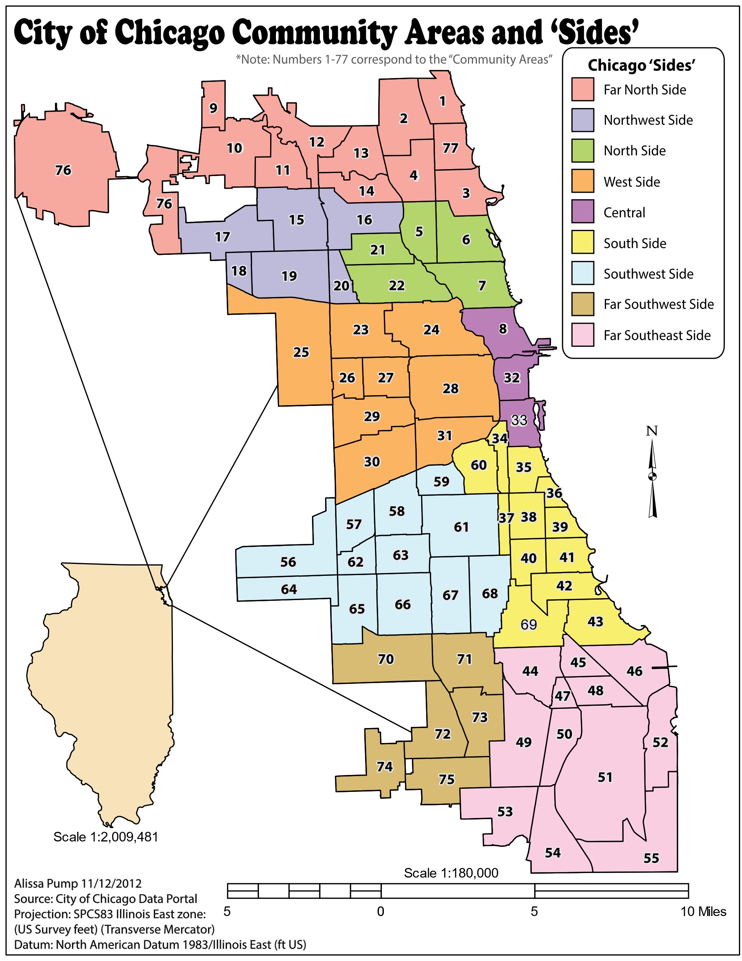
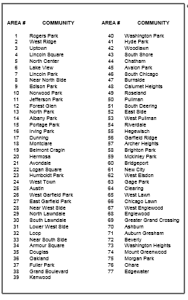
Maps: Used to create a csv linking file

Slide 5
Combining the Data
Step One: CSV file created with community names, ids, and sides.
Step Two: Reduce the census & crime files. Rename columns.
Step Three: Combine the three data files.

Slide 6
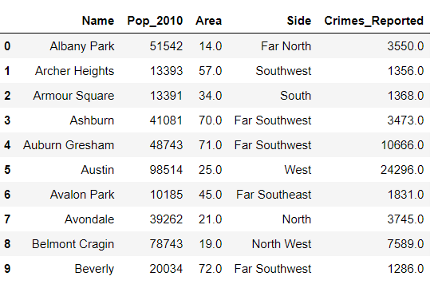
Final Data Frame

Slide 7
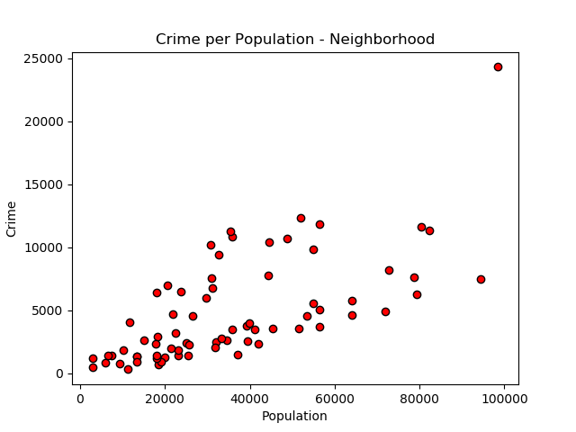
Scatter Plot: Community Areas & Crime

Slide 8
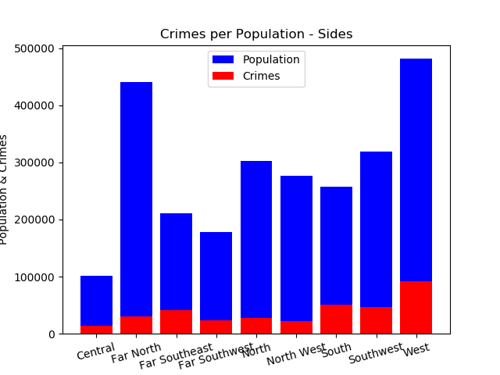
Bar Graph: Chicago Sides and Crime

Slide 9
Statistical Testing
T-Test completed using actual crime data vs expected crime data.
The null hypothesis was accepted: The population of a
Chicago community area or side does not impact the number of crimes reported in a year.

Slide 10
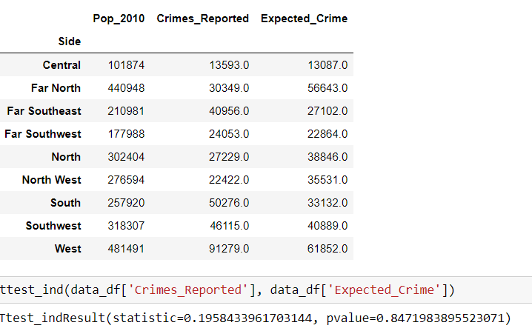
Acceptance of Null Hypothesis

Slide 11
A “What If” Redo
Use another set of data from the census file instead of population.
Compare different scenarios from the census data to see what does impact crime.
Compare Chicago crimes reported to other large U.S. cities.
Compare the crime rates of the last two censuses (2000 & 2010).

